Slide 1
PPS MINI PROJECT PHONE BOOK MANAGEMENT SYSTEM
RUPSA GHOSH, MUKESH KUMAR, MAHODHATHY KANNAN

Slide 2
Introduction
A Phone Book Management System in C is a console application without graphics. This simple mini project in C creates an external file to store the user's data permanently to perform file handling operations. File handling and data structure concepts has been extensively used for almost all functions in this mini project. Adding new records, listing them, search for contacts saved, and modify them and updating, and deleting the phonebook record are the basic function which make up the main menu of this phonebook. Personal information such as name, phone number, address, father’s name, mother’s name, gender, email are asked while adding a record into the phonebook. These records can then be listed, searched, modified for and removing. Many functions have been used in this project. These functions are easy to understand as their name only signifies their respective operations.

Slide 3
Modules
The software architecture consists of the following modules: Pre-processor commands, Functions, Variables, Statements & Expressions.
Module - 1 (header files):
#include<stdio.h>
#include<string.h>
#include<stdlib.h>
Module - 2 (declaring functions):
This function displays the user to select their choice of operations.
Module - 3 (main function):
A function declared in a class named phone book in a program.
Module - 4 (adding menu):
This module is used for inputting menu details.

Slide 4
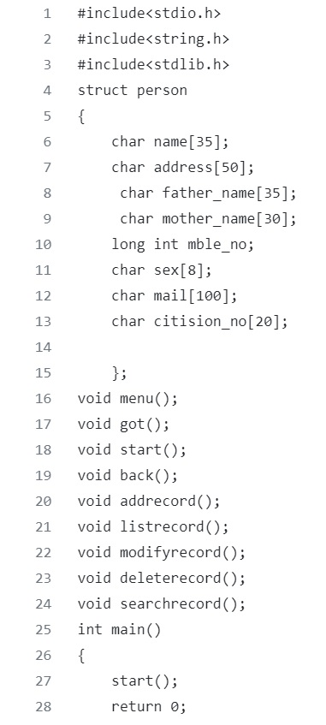
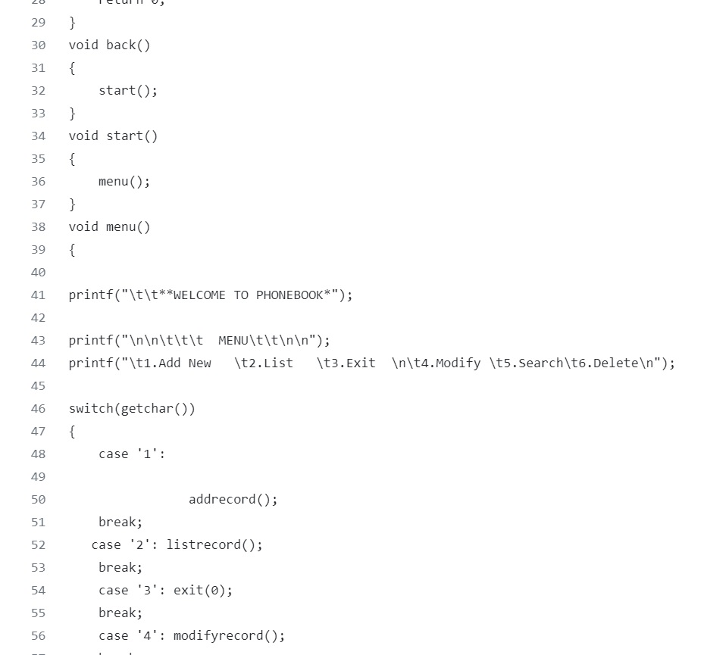
Source Code

Slide 5
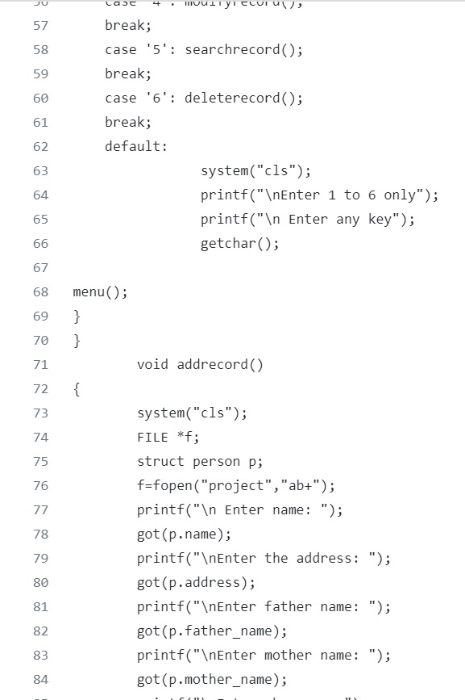
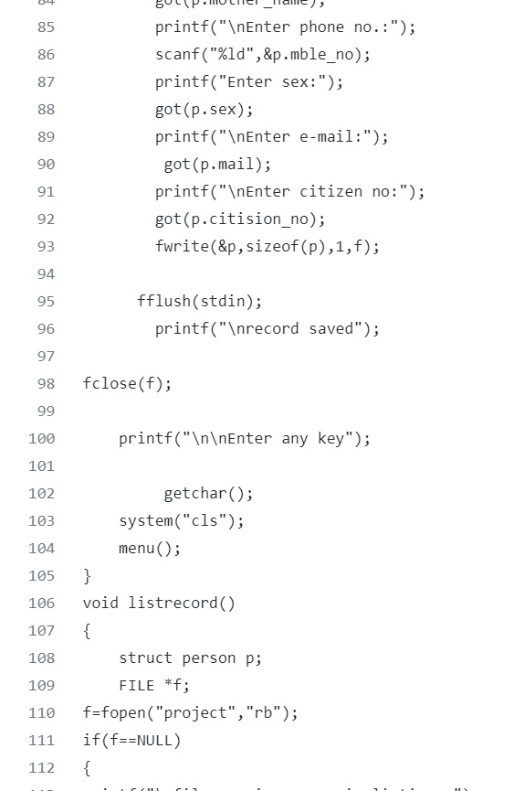

Slide 6
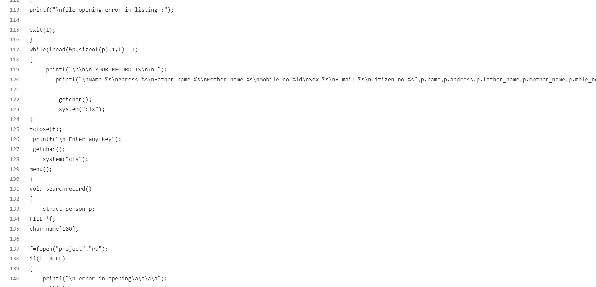

Slide 7
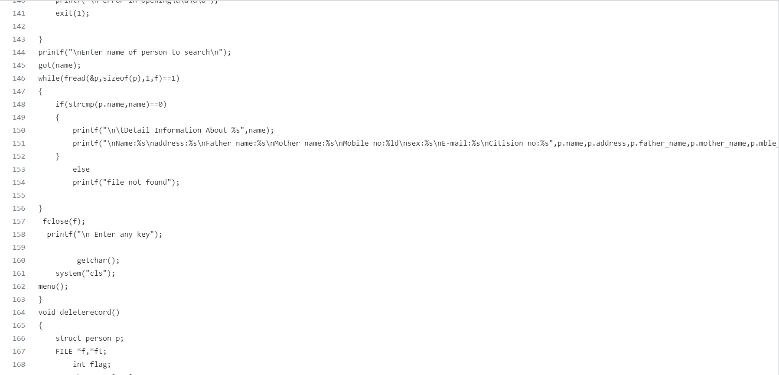

Slide 8
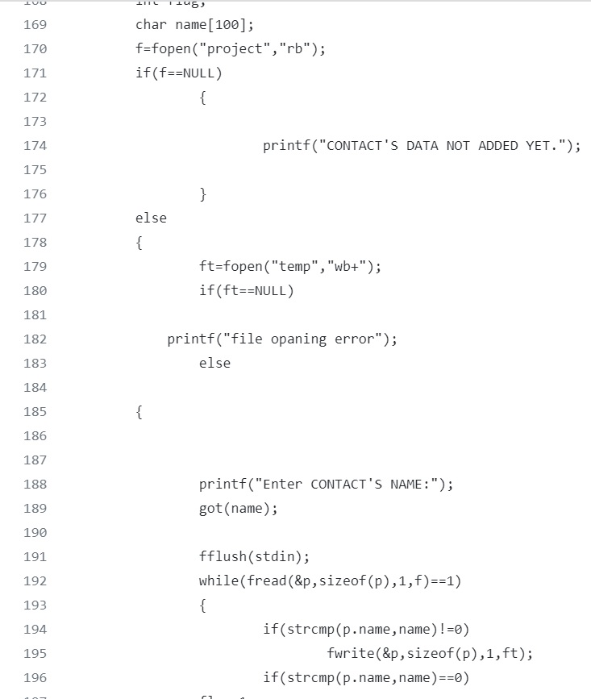
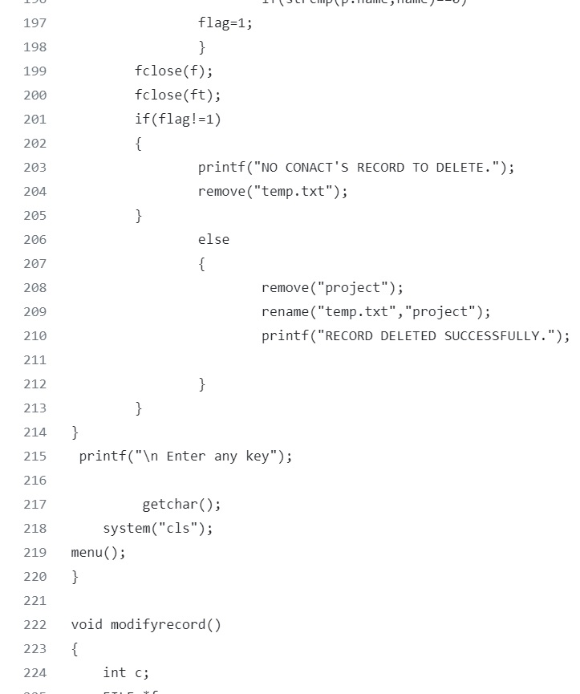

Slide 9
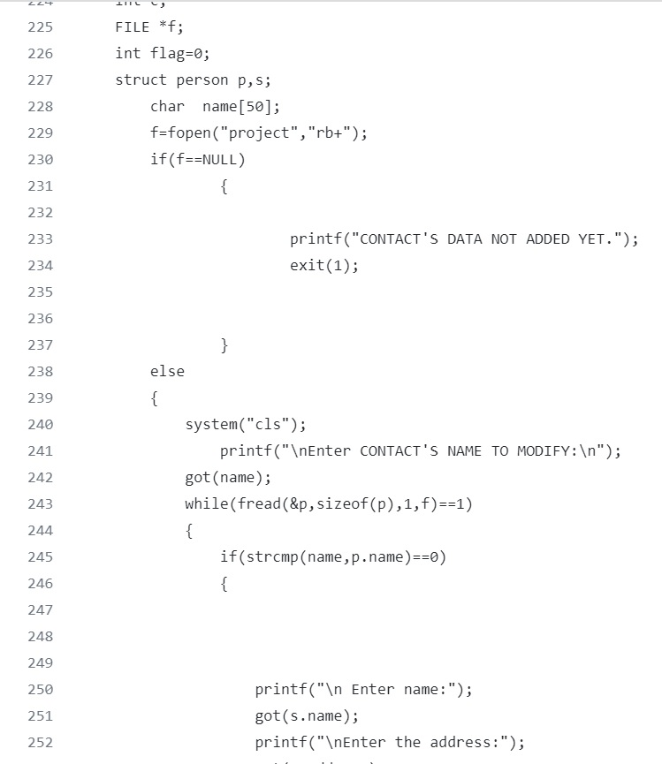
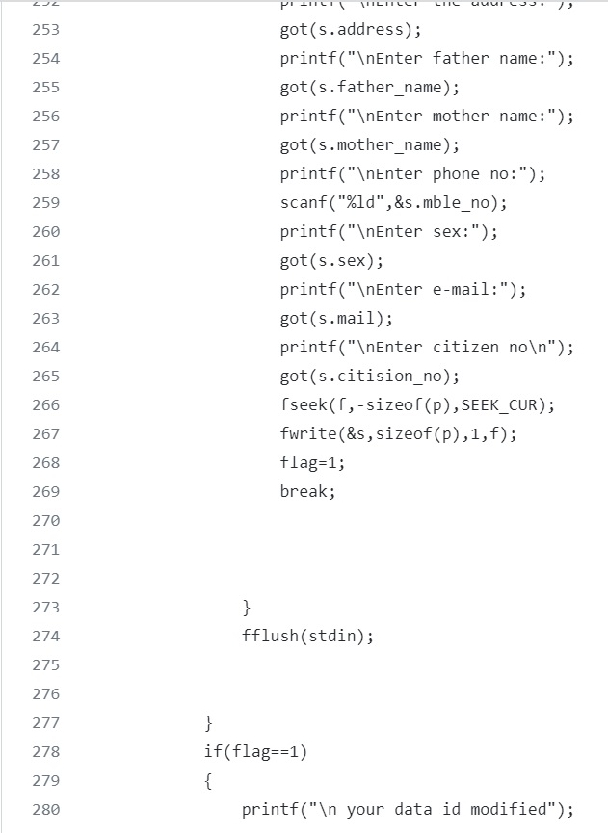

Slide 10
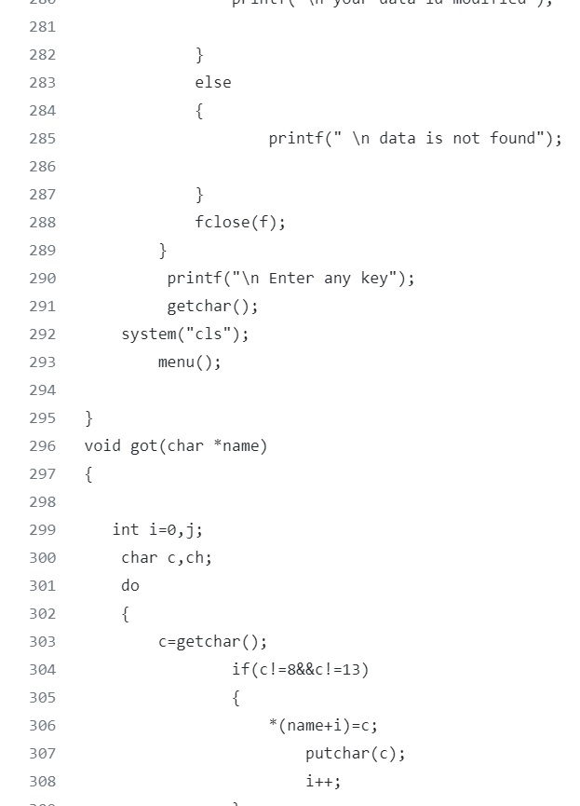
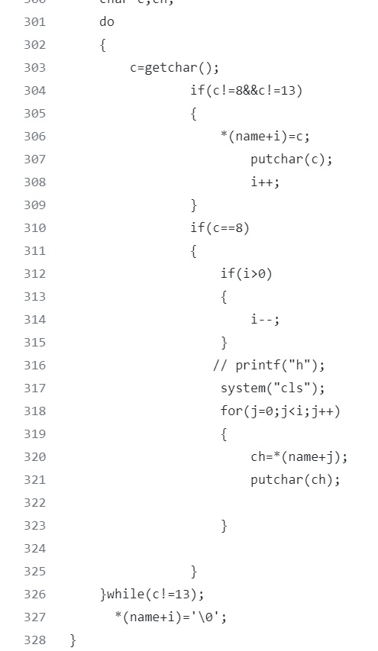

Slide 11
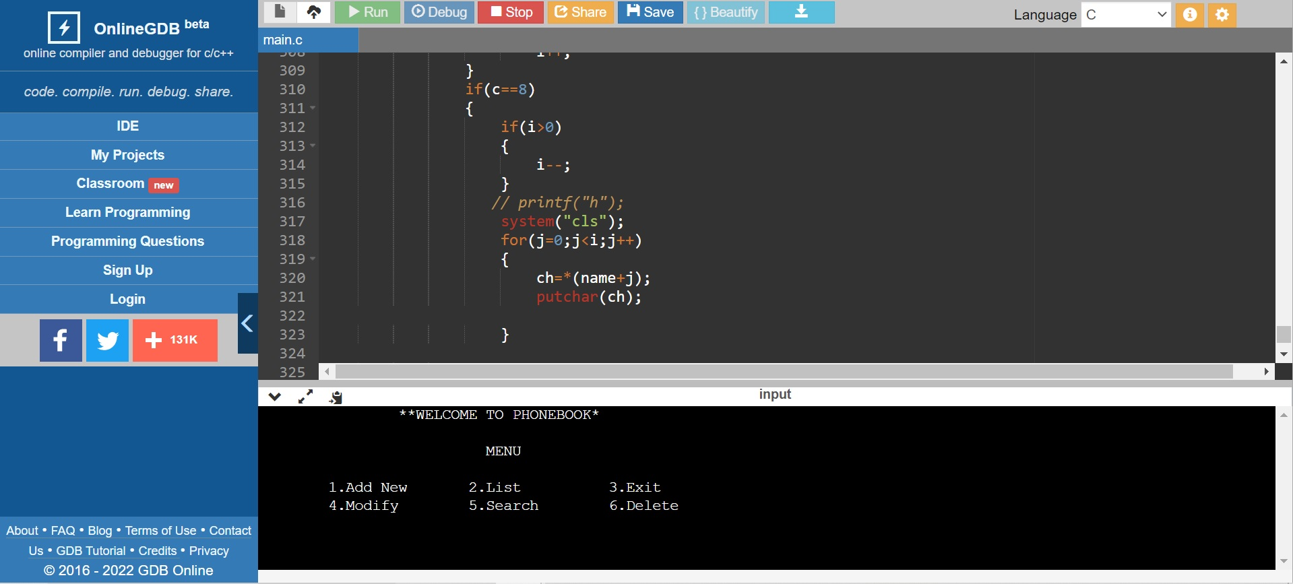
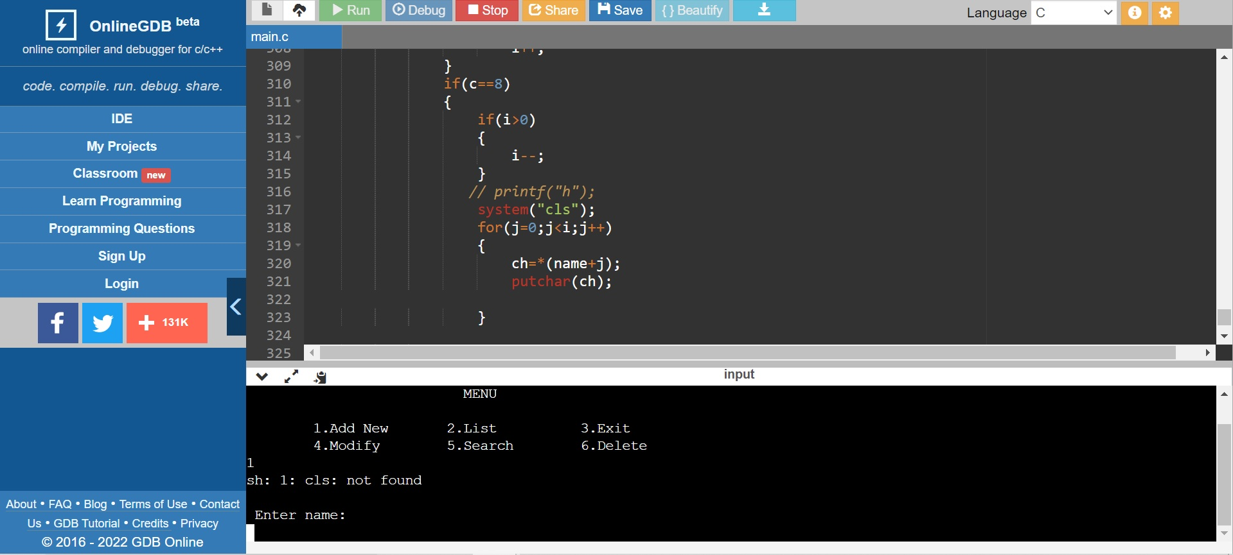
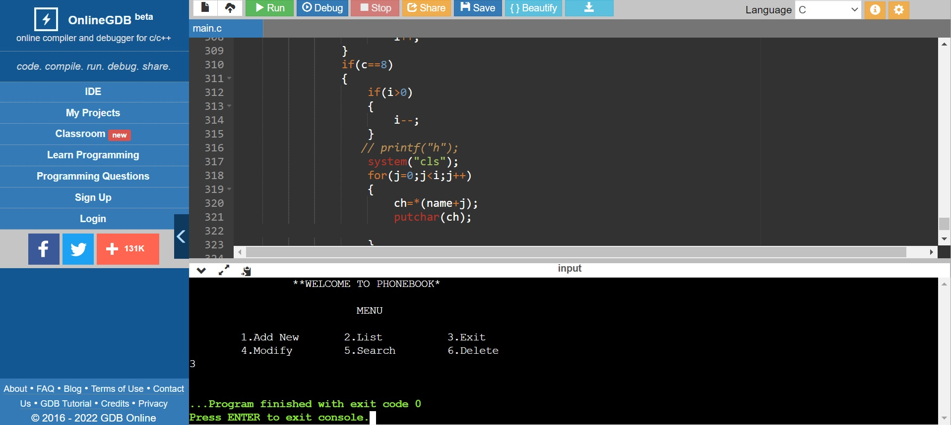
Output

Slide 12
Split up of work
RUPSA GHOSH (RA2111037010058) – Coding and debugging
MUKESH KUMAR (RA2111037010080) – Coding and debugging
MAHODHATHY KANNAN (RA2111037010054) – Presentation preparation

